Slide 1

Logic Programming
Chapter 4
Companion slides from the book

Slide 2
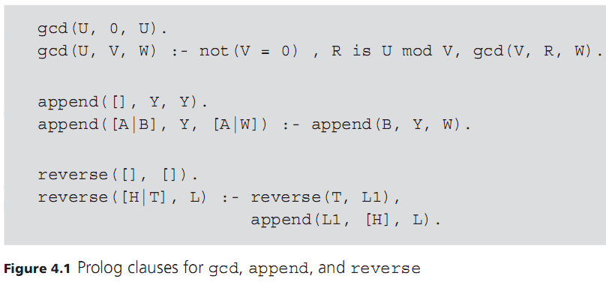
Unification (cont’d.)

Slide 3
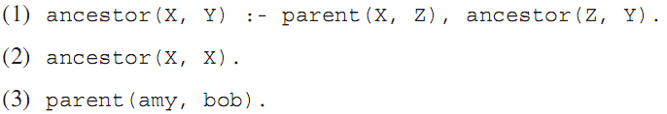
Prolog’s Search Strategy
Prolog applies resolution in a strictly linear fashion
Replaces goals from left to right
Considers clauses in the database from top down
Subgoals are considered immediately
This search strategy results in a depth-first search on a tree of possible choices
Example:

Slide 4
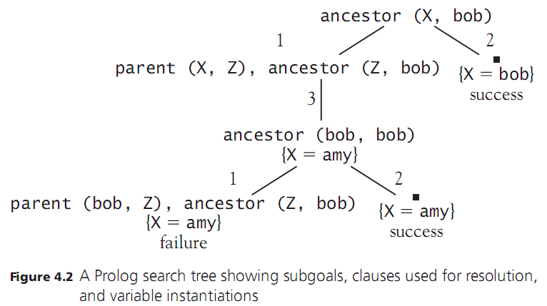

Slide 5
Prolog’s Search Strategy (cont’d.)
Leaf nodes in the tree occur either when no match is found for the leftmost clause or when all clauses have been eliminated (success)
If failure, or the user indicates a continued search with a semicolon, Prolog backtracks up the tree to find further paths
Releases instantiation of variables as it does so
Depth-first strategy is efficient: can be implemented in a stack-based or recursive fashion

Slide 6
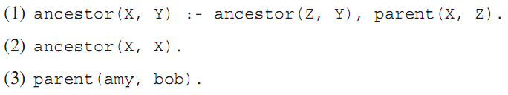
Prolog’s Search Strategy (cont’d.)
Example: same clauses in different order
ancestor(X,bob)
ancestor(Z,bob), parent(X,Z)
{X=bob}
Success
ancestor(Z’,bob), parent(Z,Z’), parent(X,Z)
1
2
Can be problematic if the search tree has branches of infinite depth

Slide 7
Infinite Loop
Causes Prolog to go into an infinite loop attempting to satisfy ancestor (Z, Y), continually reusing the first clause
Prolog evaluates the clauses in left recursive manner
Breadth-first search would always find solutions if they exist
Far more expensive than depth-first, so not used

Slide 8
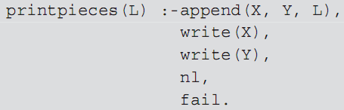
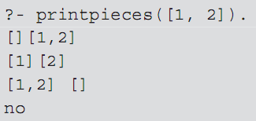
Loops and Control Structures
Can use the backtracking of Prolog to perform loops and repetitive searches
Must force backtracking even when a solution is found by using the built-in predicate fail
Example:

Slide 9

Loops and Control Structures (cont’d.)
Use this technique also to get repetitive computations
Example: these clauses generate all integers greater than or equal to 0 as solutions to the goal num(X)

Slide 10
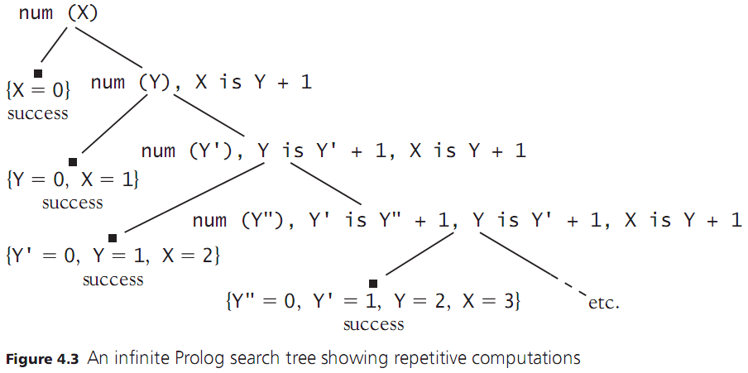
Loops and Control Structures
The search tree has an infinite branch to the right

Slide 11
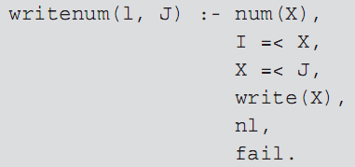
Example: trying to generate integers from 1 to 10
Causes an infinite loop after X = 10, even though X =< 10 will never succeed

